Slide 1
Traffic sign board detection -Using convolutional neural network

Slide 2
Objective:
The main objective of this project is to develop a robust and accurate traffic sign board detection system using Convolutional Neural Networks (CNNs) with the ultimate aim of improving road safety and traffic management.
The system will be designed to accurately detect and classify different types of traffic sign boards from images or video frames in real-time, even in challenging conditions.
The project seeks to leverage the power of deep learning to provide a practical solution that can be integrated into existing traffic management or driver assistance systems, allowing for better traffic flow, enhanced driver awareness, and improved compliance with traffic regulations. The system has potential uses in traffic monitoring, law enforcement, driver assistance, and urban planning, with the goal of making roads safer and more efficient for all road users.

Slide 3
Understanding the Data:
The training data consists of 43 different types of sign board(43 folders) data in the image format
The training data consists of images captured in many kind of environment like different angles, different lightings, clear and blurred, etc
For each sign board type separate folder is made and a unique number is giving

Slide 4
Understanding the Data:
0:'Speed Limit-20',
1:'Speed Limit-30',
2:'Speed Limit-50',
3:'Speed Limit-60',
4:'Speed Limit-70',
5:'Speed Limit-80',
6:'End of Maximum speed-80',
7:'Speed Limit-100',
8:'Speed Limit-120',
9:'No Passing (overtaking) for any vehicle
type except one line (track) transport
(like motorcycles and mopeds)',
10:'No passing for vehicles with a total weight
of over 3.5 t',
11:'Indicates priority only at the upcoming
intersection or crossing',
12:'Priority Road starts',
13:'Yield right-of-way',
14:'STOP',
15:'No entry for any type of Vehicle',
16:'No entry for motor vehicles with a
maximum authorized mass of more than 3.5 t',
17:'Do not enter',
18:'This is a general danger or warning sign.',19:'A single curve is approaching in the left direction',
20:'A single curve is approaching in the right direction'
21:'Indicates an approaching double curve - first to the left',
22:'Warning of a rough road ahead.',
23:'The danger of skidding or slipping.',
24:'he road narrows from the right side',
25:'Work in process',26:'Indicates the traffic signal ahead.',
27:'Pedestrian crossing ahead.',
28:'Pay attention to children ',29:'Be aware of cyclists',
30:'Beware of an icy road ahead.',
31:'Indicates wild animals may cross the road',
32:'End of all previously set passing and speed restrictions',
33:'Indicates that traffic must turn right',34:'ndicates that traffic must turn left',
35:'The mandatory direction of travel is straight ahead. No turns are permitted',
36:'Mandatory directions of travel, straight ahead or right',
37:'Mandatory directions of travel, straight ahead or left',
38:'Prescribed drive direction around the obstacle. Drive from the right of the obstacle.',
39:'Prescribed drive direction around the obstacle. Drive from the left of the obstacle',
40:'Indicates entrance to a traffic circle',
41:'End of the no-passing zone for vehicles under 3.5 t',
42:'End of all passing (overtaking) restrictions'}

Slide 5
Steps :
Step 1 = Importing libraries required for the project
Step 2 = -Importing data folders
-extracting every images in the data one by one and resizing
the images into the size (32 X 32) and converting into array
format
Step 3 = Splitting Train and test data
Step 4 = Building a sequential model using Convolution Neural Network

Slide 6
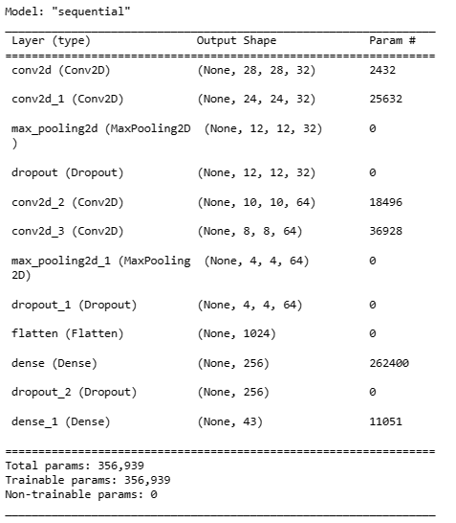

Step 4 =
Building a sequential model
using Convolution Neural Network
creating labels for y_train and y_test
from 0 to 43 for multiclass classification

Slide 7
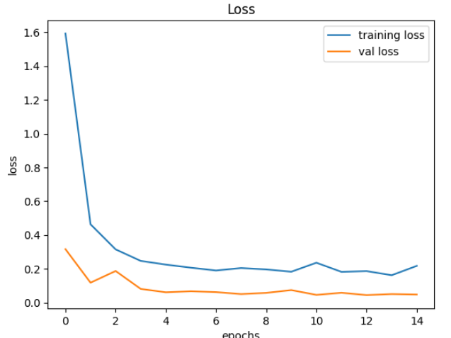
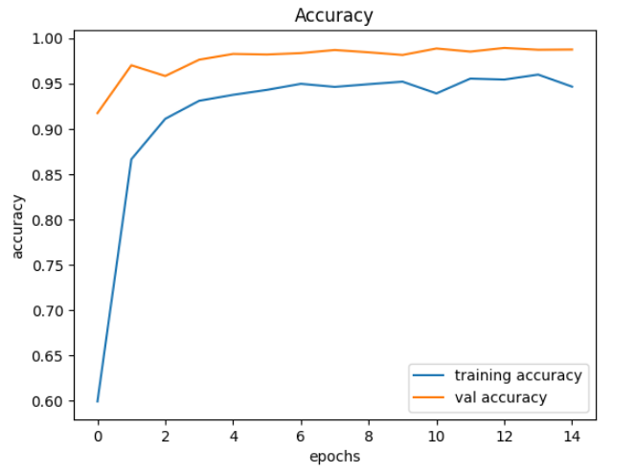
Step 5 =
Selecting best number of epochs where training and testing accuracies are close and loss is low
training and testing accuracies are close around the 13 to 15 epochs and loss also low
So 15 epochs yields a general model

Slide 8
97.8% Accuracy achieved at 15th epoch
Step 6 = Selecting random test image from test data and predicting the output

Slide 9

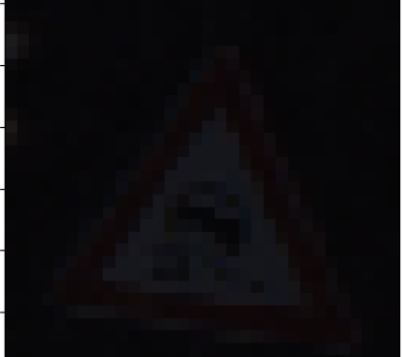
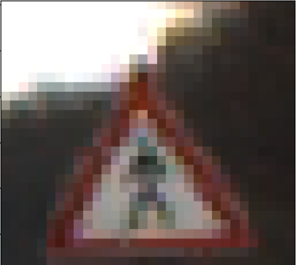








Some predictions from the model :

Slide 10


